Slide 1
УРОК АНГЛИЙСКОГО ЯЗЫКА В 10 КЛАССЕ
Емцева Инна Эдуардовна
Бюджетное общеобразовательное учреждение города Омска
«Лицей №145»
учитель английского языка

Slide 2
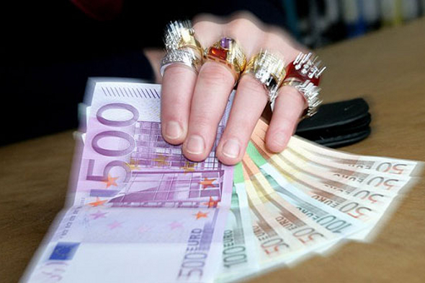
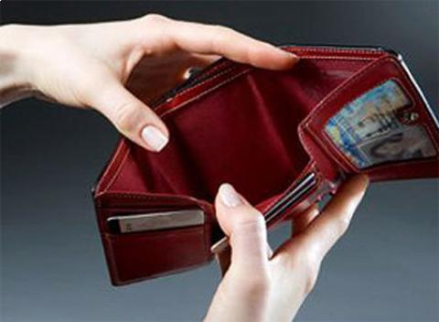
Определение темы урока
Can you define the topic of our lesson?

Slide 3
“A penny saved is a penny earned”
“Money”
“Are you materialistic?”
Is it difficult to spend money?

Slide 4
Listening for details
Reading for gist
Work with idioms
Speaking(role play)

Slide 5
Listening
Listen to the conversation and answer the questions:
1.Where is one of the speakers going?
2.Where is it situated?
3.What is she planning to do there?
4.What are the advantages of going there?
5.How much money did she manage to save last time?

Slide 6
Reading
Read the text and decide whether these statements are true or false:
1.Some people have small incomes-
2.If you spend more money than you earn, you want to show off-
3.A credit card is a small plastic card for keeping a salary.
4.When people owe money on credit cards they should pay extra money.-
What is the main idea of the text? Should we spend money carefully?

Slide 7
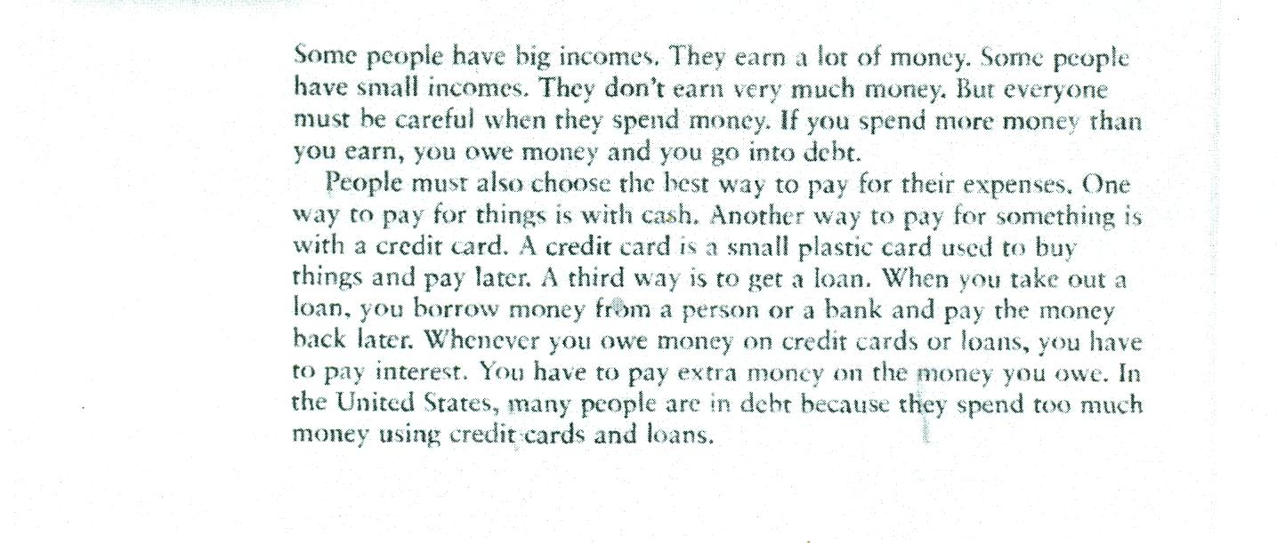

Slide 8
Work with idioms
1.Be on the breadline
2.Live in the lap of luxury
3.Well-off/well-to-do/well-heeled
4.Spend money like water
5. Tighten your belts
6.Make a killing
7.be a money spinner
Put these expressions in order from rich to poor:
Living in the lap of luxury-on the breadline-well-to-do-well-heeled.
http://lenacom.spb.ru/english/-тесты по английскому языку
идиомы, фразовые глаголы, краткий справочник по грамматике.

Slide 9
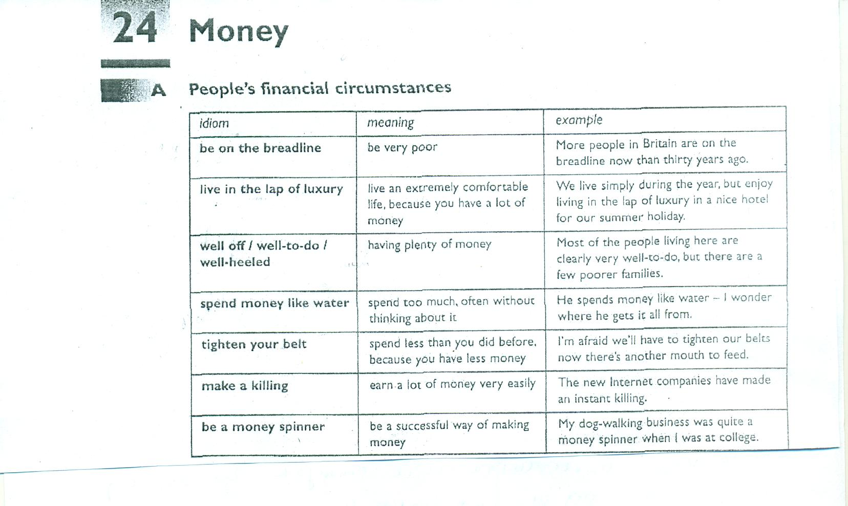

Slide 10
Work with idioms
Read the small conversations and decide which person in each pair of speakers is probably more satisfied:
1.Ann: Our new business venture means we`re going to
tighten our belts.
Bob:We`re making a killing with our new business venture.
2.Colin:Our new car cost a small fortune.
Daisy: Our new car was a rip-off.
3.Ed: My daughter spends money like water.
Fred: My daughter`s quite well off.
4.Gill: This business venture has put paid to our hopes of success.
Harry: This business venture has brought success, but at a
considerable price.

Slide 11
Role play
Work in groups
1.The first group-parents
2.The second group-teachers
3.The third group-students
You school has been offered a donation of 100000 roubles.
Decide how you will spend the sum.
Is it difficult to decide?

Slide 12
Evaluation
Try to evaluate yourselves and your
classmates.

Slide 13
Home assignment
ex.3,5 pp 69-70
ex.1,2,4 pp 68-70

